Slide 1
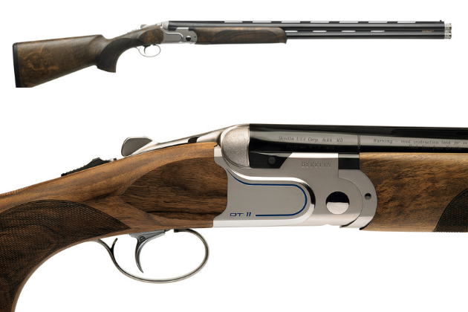
Beretta DT11
By: Edward Tunbridge

Slide 2
The overall thickness of the DT11 receiver is 3 mm wider than DT10. The increased width went all to enhancing the walls with the additional weight been placed right where the point of balance is making the gun point better more stable with less recoil and more durable

Slide 3
Improved grip and operation
The DT11 has a redesigned top lever which helps to improve your grip when opening and closing the gun. Incredible for both left and right handed shooters.
The shape of the safety lever has also been redesigned for smoother operation

Slide 4
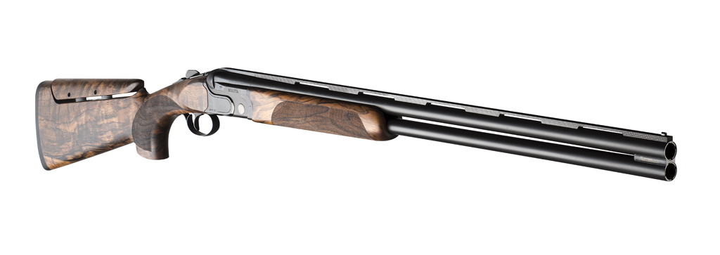
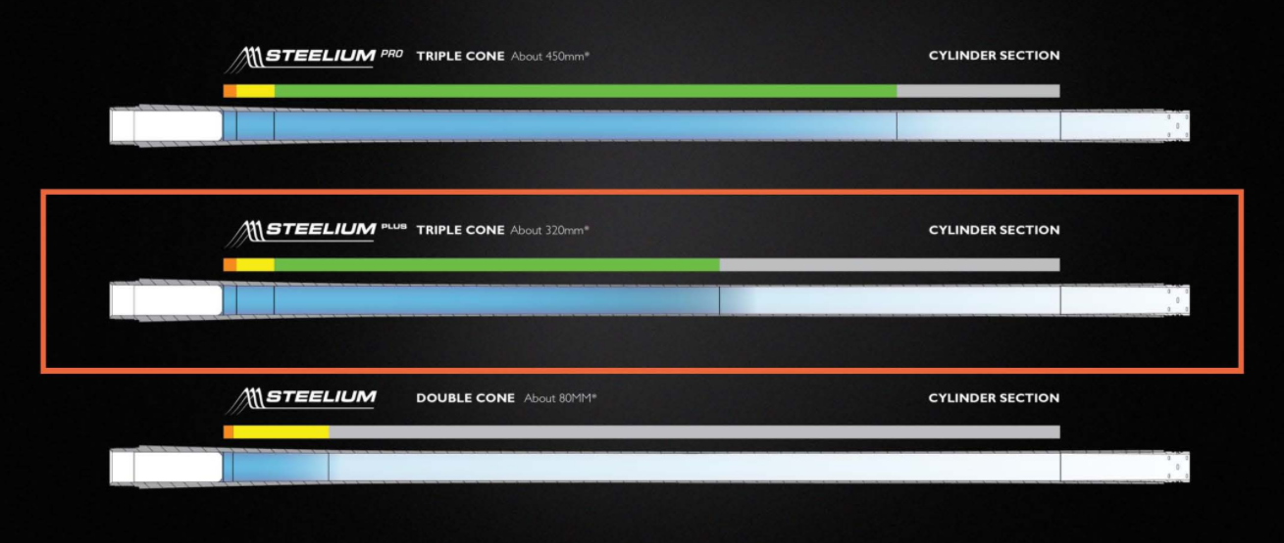
Steelium Pro Barrels
The side ribs are windowed to improve balance and help dissipate heat
Barrels are premium grade Stealium pro Barrels with a 480mm forcing cone which gives the shooter a much better ballistic performance with consistent patterning whilst reducing recoil and muzzle rise

Slide 5
At 480mm (18.9"), the DT11 forcing cone is extra long, to practically eliminate shot deformation and to reduce felt recoil and muzzle rise.

Slide 6
Steelium Barrels
Steelium is a proprietary tri-alloy blend that Beretta uses for barrels. Among the many benefits it offers is a combination between lightness and exceptional resistance to shock and deformation. For the hunter, this means absolute shot consistency (steel or lead), accuracy and a shotgun that will give you several lifetimes of enjoyment.

Slide 7
Drop Trigger
The trigger group is easily detachable for quick and trouble-free cleaning and maintenance. Also, the main parts of the trigger group are captive. Out of the box, trigger breaks at 3.5lbs for a truly crisp and consistent feel.

Slide 8
OptimaBore HP Chokes
Optima-Bore HP choke geometry was conceived to offer the best ballistic performance available, with steel or lead shot. Thanks to its design, shot pattern remains perfectly uniform whatever the shell size or load, giving you consistency and accuracy while shooting. Optima-Bore HP choke tubes further enhance the effect.

Slide 9
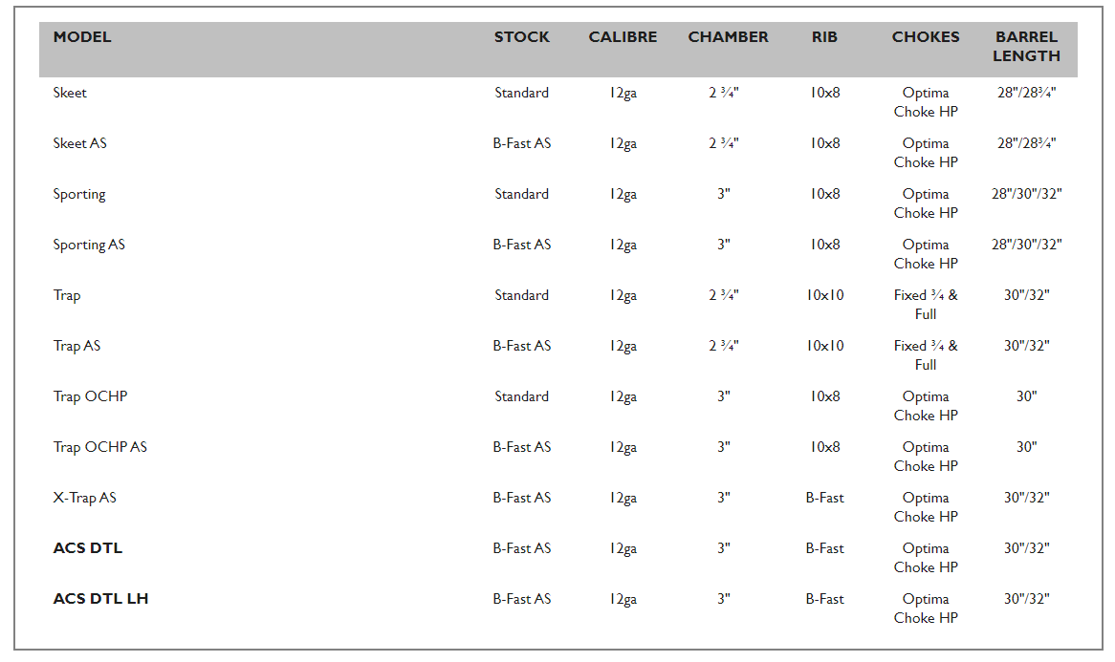
Configurations

Slide 10
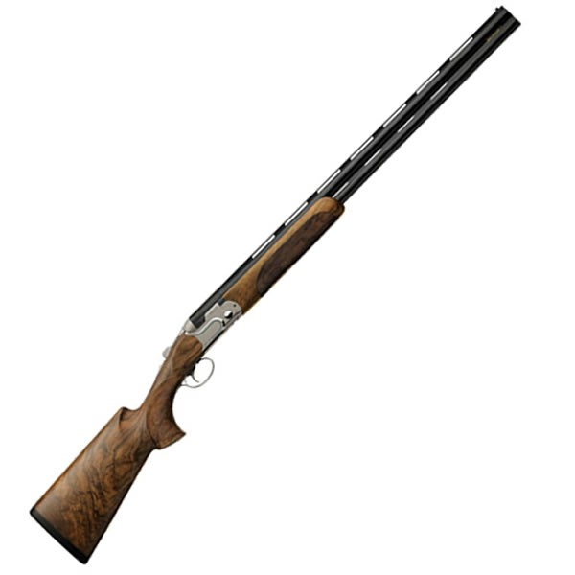
Pricing
Sporting and Skeet models
Normal = $14,400 - $14,900
Black = $16,500 - $17,100
Black pro (TSK Stock) = $18,600
Trap models
Normal = $14,000 - $14,500
Black = $16,100 - $16,700
Other models
ACS DTL = $15,200
X Trap = $15,500
DTL = $15,800

Slide 11
Inquiries
edward.tunbridge@berettaaustralia.com

